Slide 1
Customer Retention Project
Rajesh.J
rajesh112j@gmail.com

Slide 2
Sequntial process involved in this project
Librirary Initialization
Loading the dataset
EDA
Univariate analysis
Bivariate analysis

Slide 3
Preprocessing of Dataset
Loading of Dataset as in the form of CSV format.
Analysing the datatypes of columns.
Identifying the Number of Rows and Columns.
Checking null values.

Slide 4
EDA
Univariate analysis using Hist plot and Count plot.
Bivariate analysis using scatter plot.

Slide 5
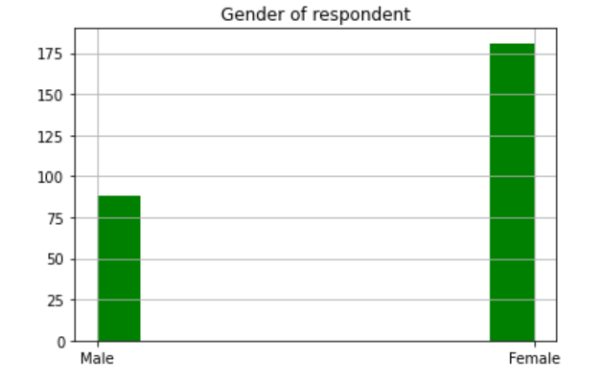
EDA
df["1Gender of respondent"].hist(grid=True,color='green')
plt.title("Gender of respondent")
plt.show()

Slide 6
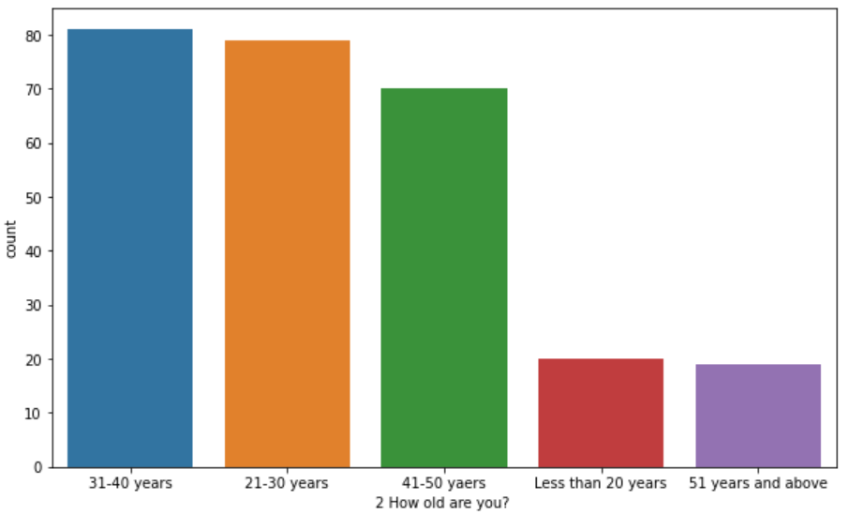
How old are you?

Slide 7
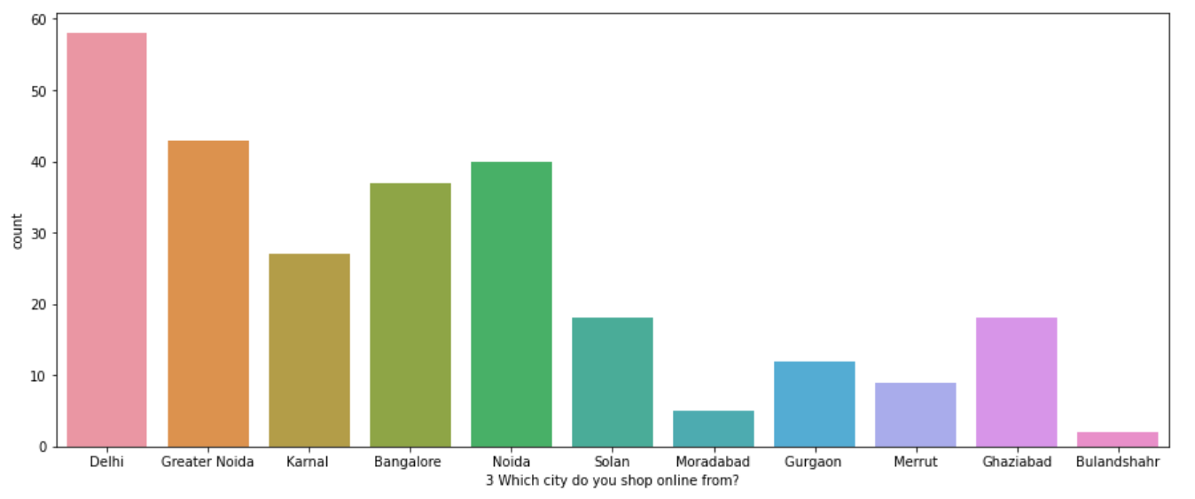
Which city do you shop online from?

Slide 8
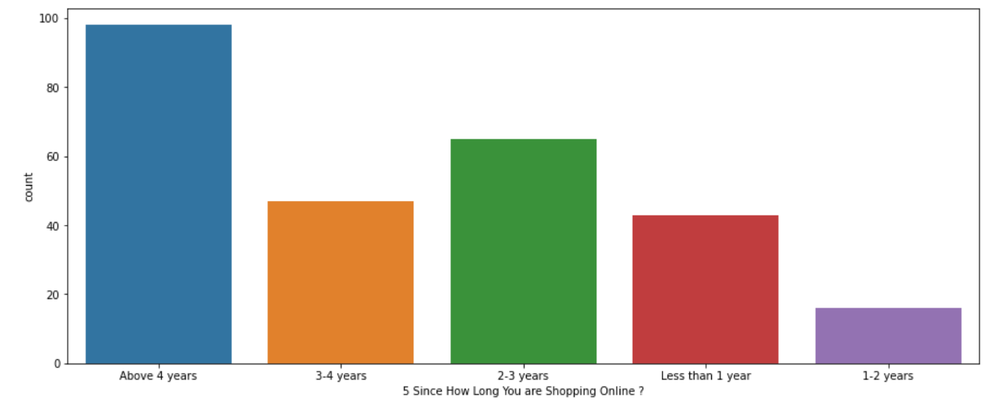
Since How Long You are Shopping Online ?

Slide 9
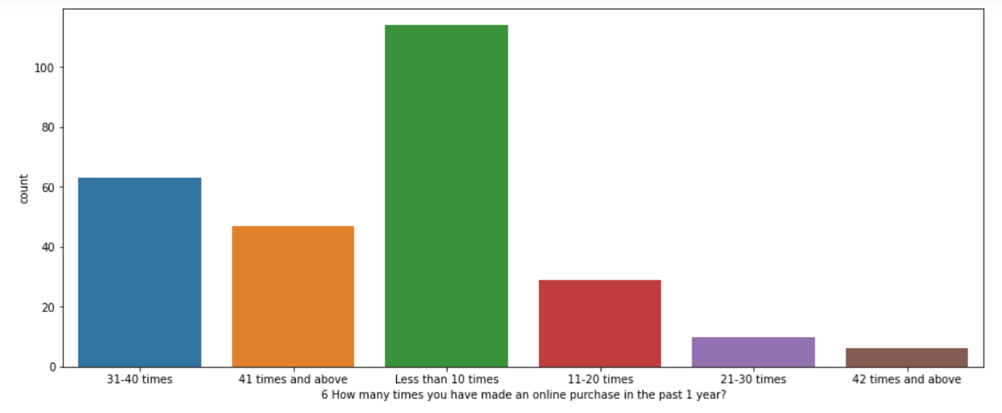
How many times you have made an online purchase in the past 1 year?

Slide 10
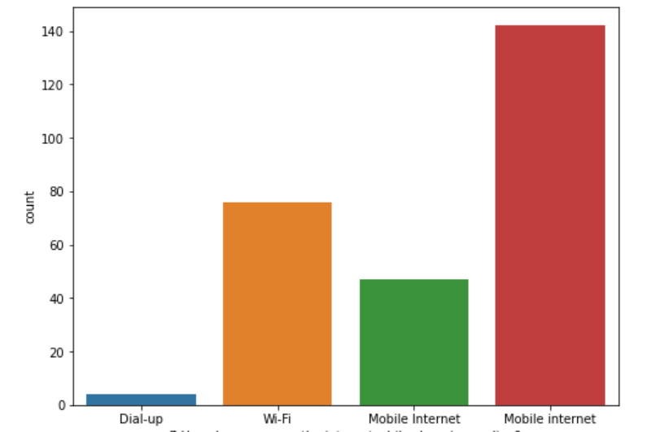
How do you access the internet while shopping on-line?

Slide 11
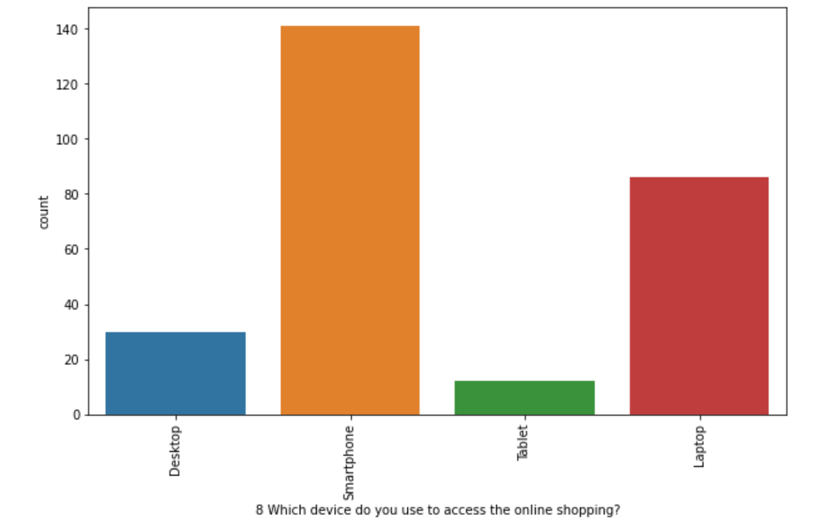
Which device do you use to access the online shopping?

Slide 12
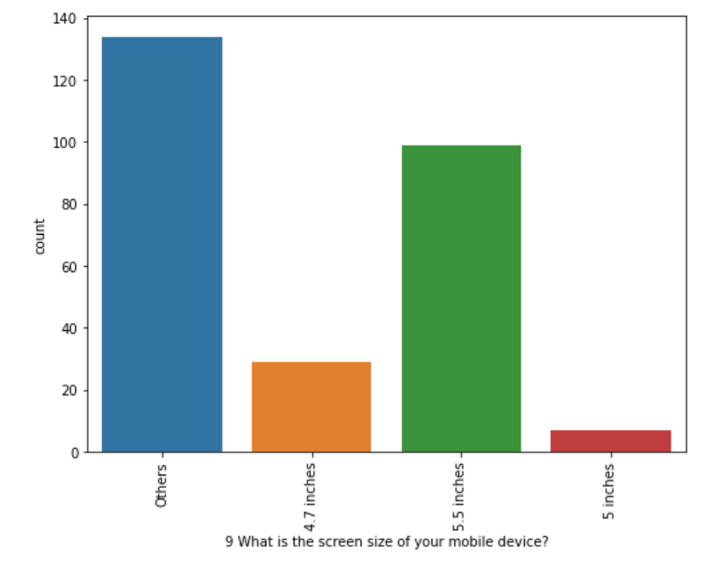
What is the screen size of your mobile device?

Slide 13
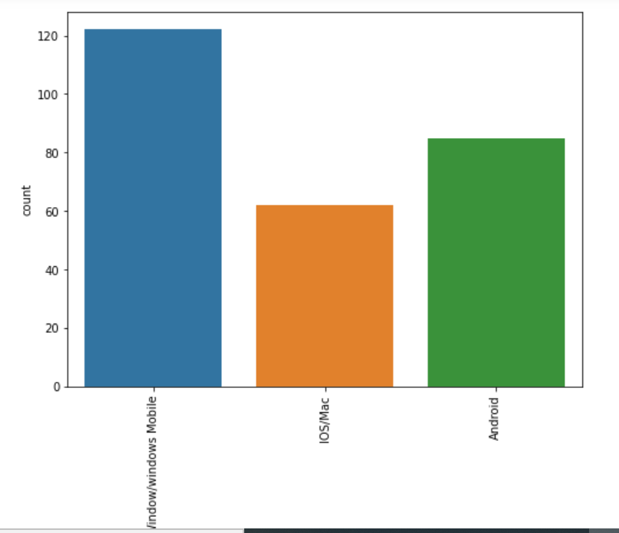
What is the operating system (OS) of your device?

Slide 14
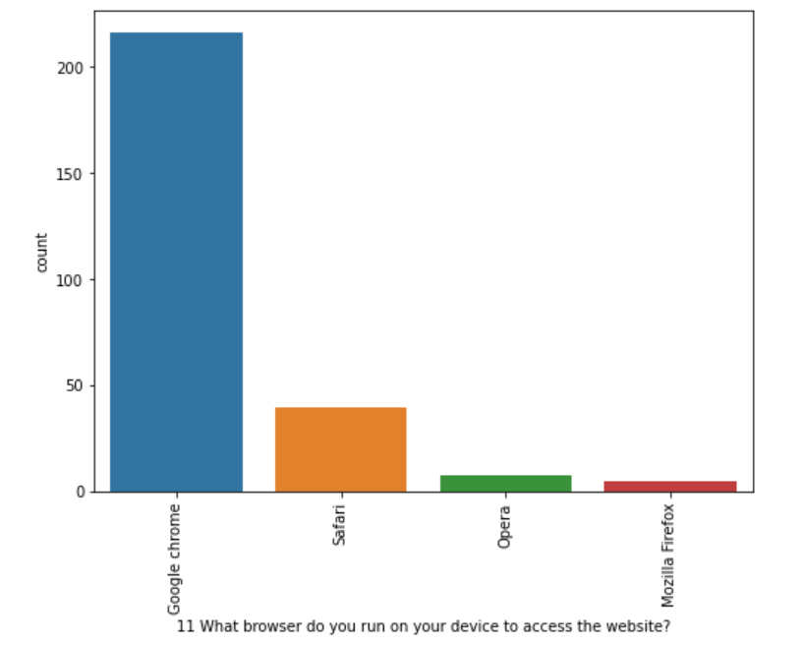
What browser do you run on your device to access the website?

Slide 15
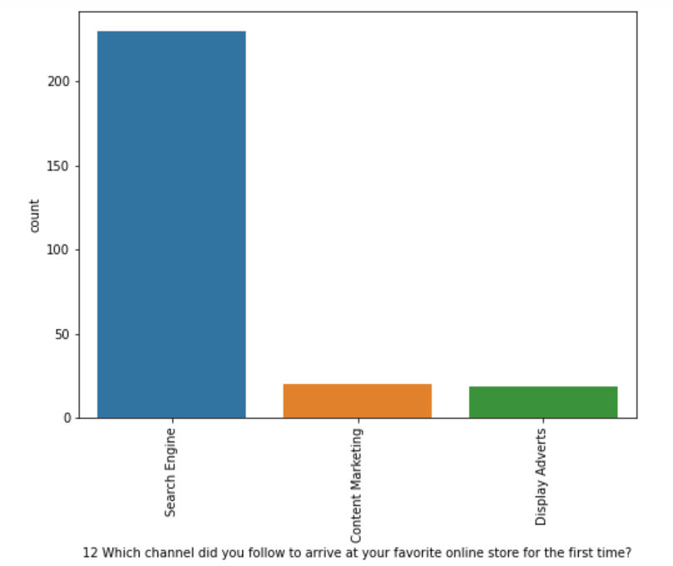
Which channel did you follow to arrive at your favorite online store for the first time?

Slide 16
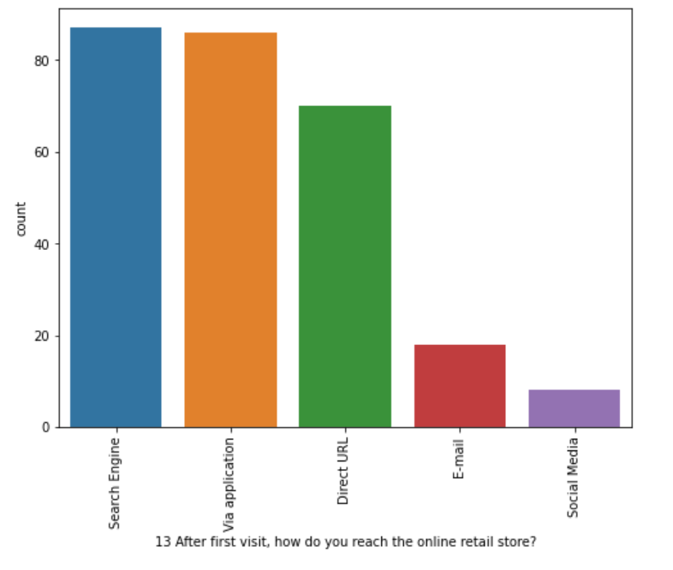
After first visit, how do you reach the online retail store?

Slide 17
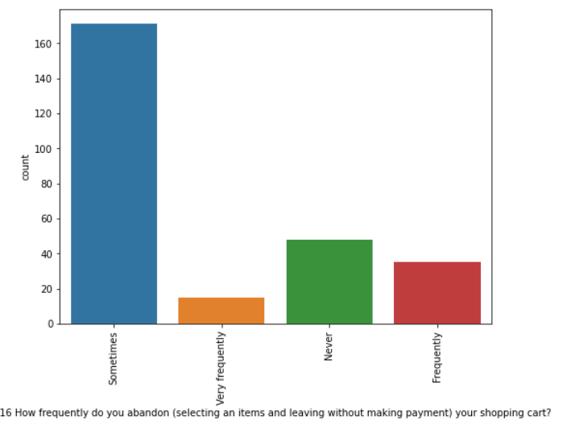
How frequently do you abandon (selecting an items and leaving without making payment) your shopping cart?

Slide 18
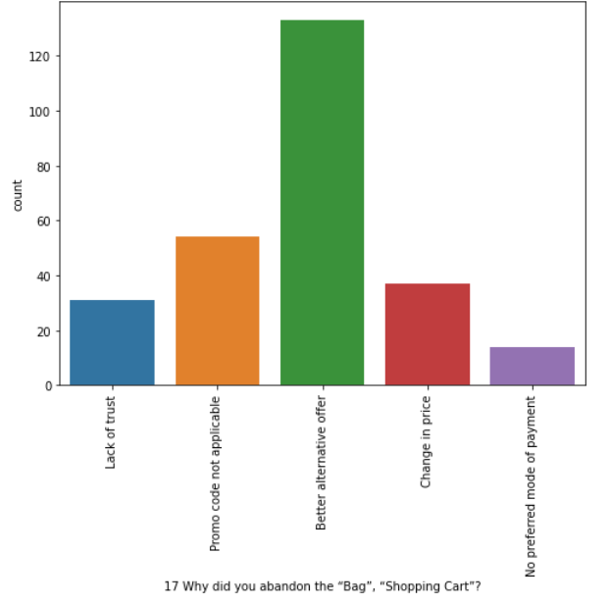
Why did you abandon the “Bag”, “Shopping Cart”?

Slide 19
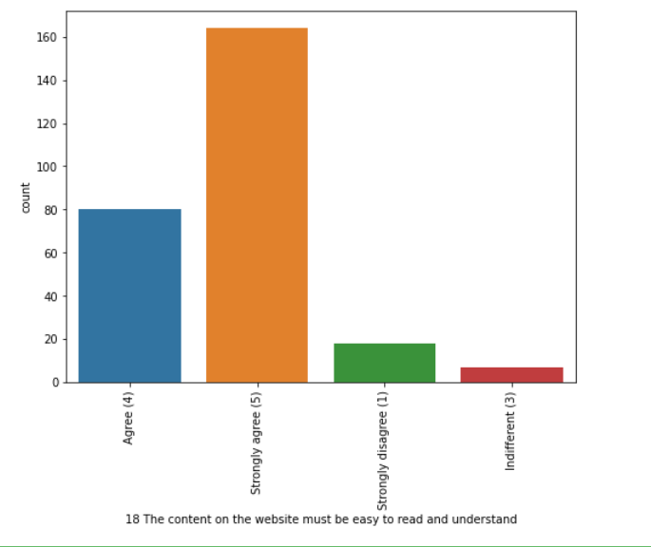
The content on the website must be easy to read and understand

Slide 20
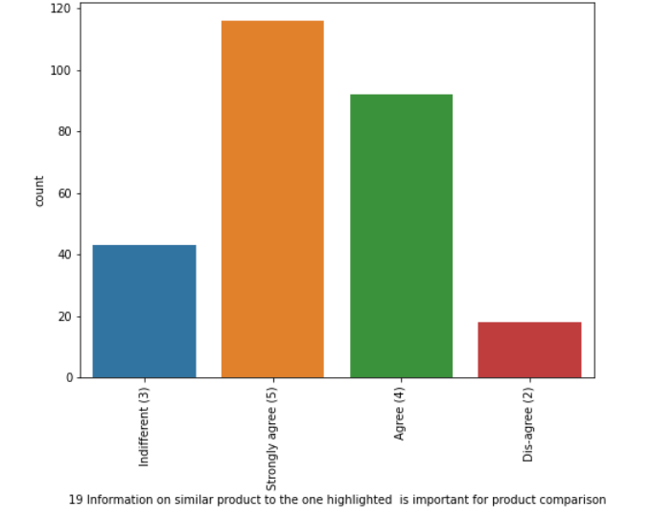
Information on similar product to the one highlighted is important for product comparison

Slide 21
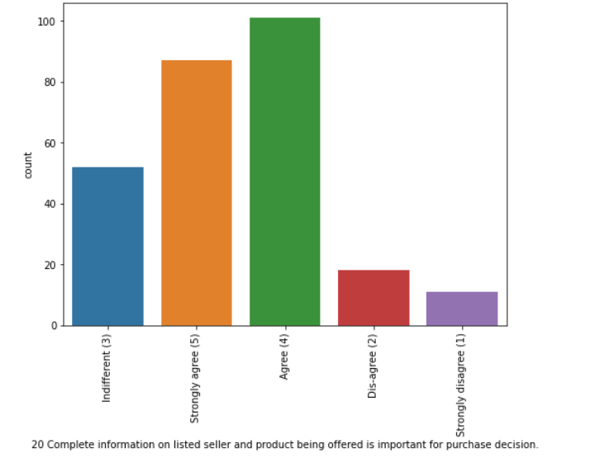
Complete information on listed seller and product being offered is important for purchase decision.

Slide 22
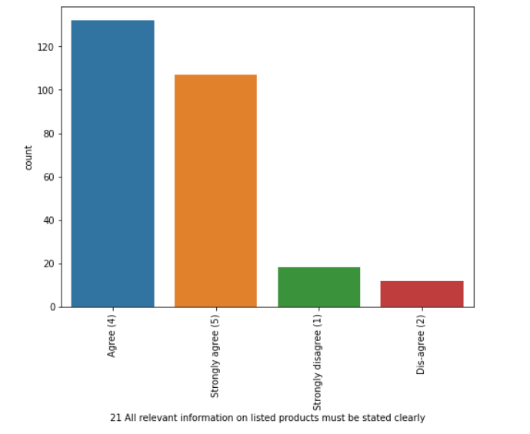
All relevant information on listed products must be stated clearly

Slide 23
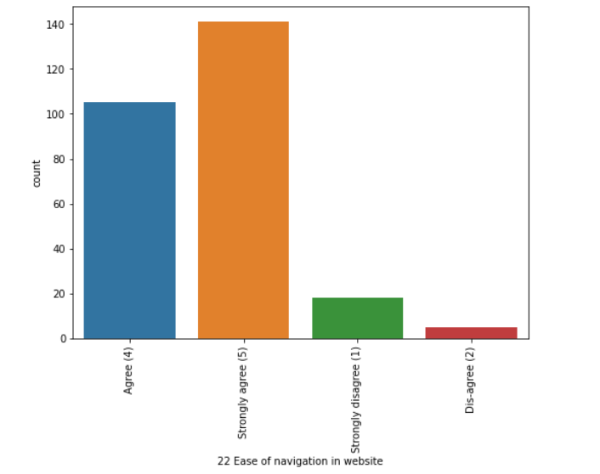
Ease of navigation in website

Slide 24
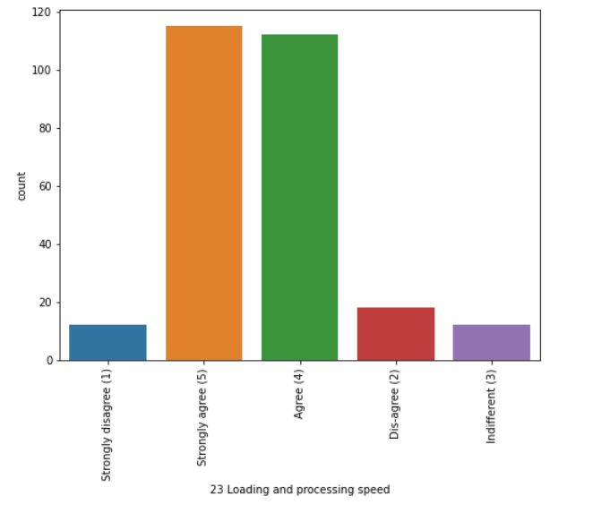
Loading and processing speed

Slide 25
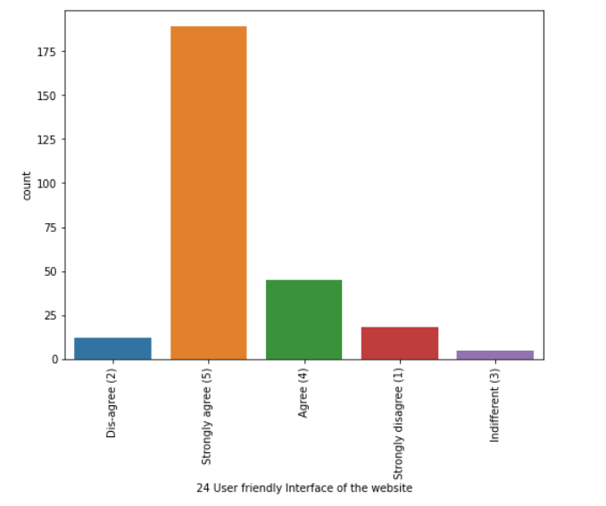
User friendly Interface of the website

Slide 26
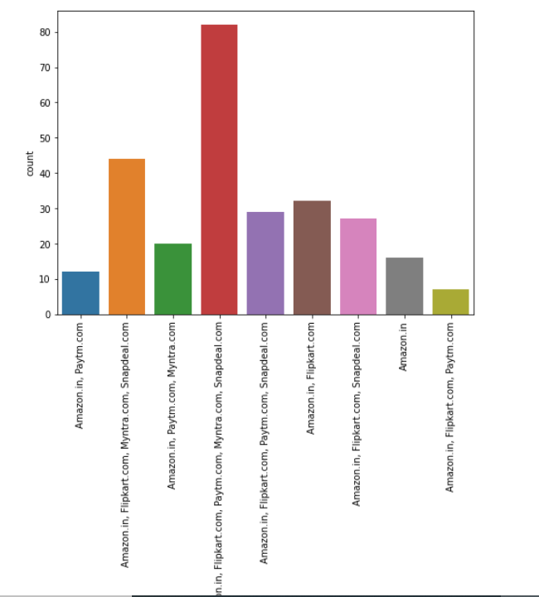
From the following, tick any (or all) of the online retailers you have shopped from;

Slide 27
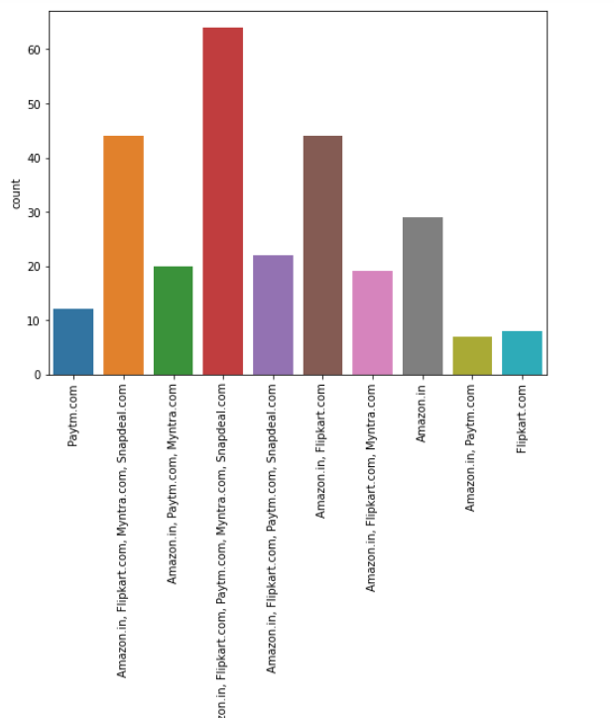
Easy to use website or application

Slide 28
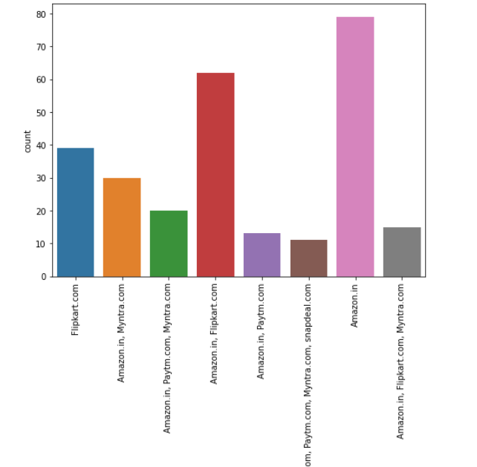
Which of the Indian online retailer would you recommend to a friend?

Slide 29
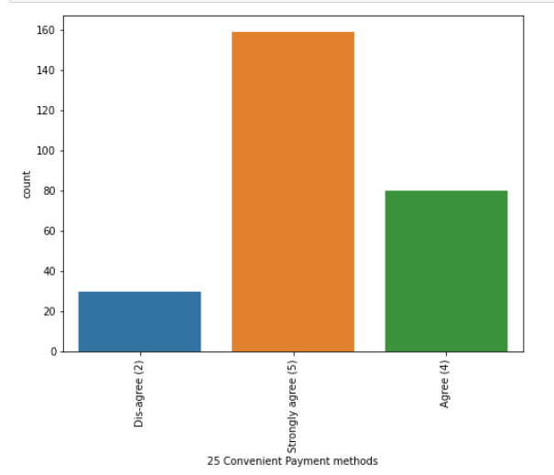
Convenient Payment methods'

Slide 30
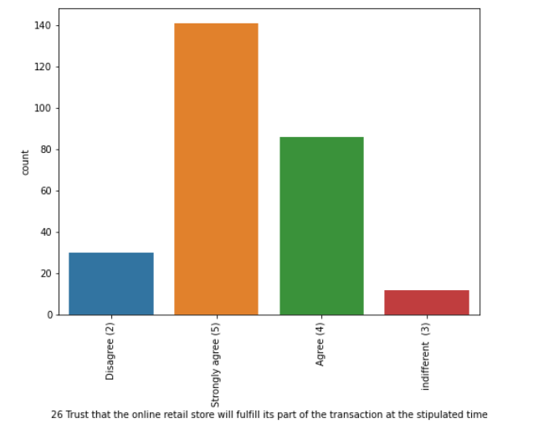
Trust that the online retail store will fulfill its part of the transaction at the stipulated time'

Slide 31
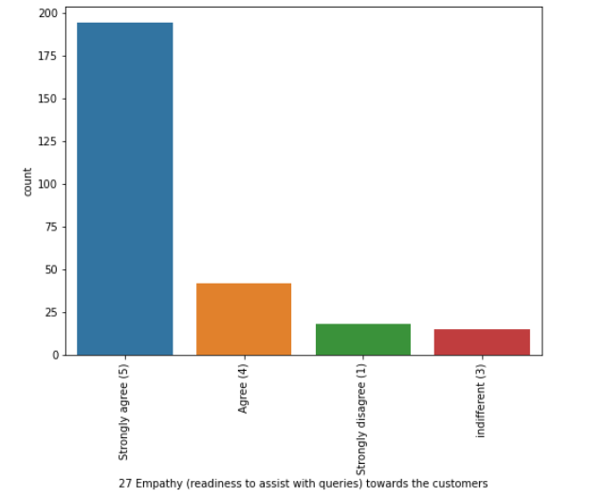
Empathy (readiness to assist with queries) towards the customers

Slide 32
Conclusion
Majority of the people Strongly agree that Online store plays vital role in Purchases with many factors as explained above exploratory analysis. Customer satisfaction has emerged as one of the most important factors that guarantee the success of online stores. Major factors that contributed to the success of an e-commerce store have been identified as: service quality, system quality, information quality, trust and net benefit. The research furthermore investigated the factors that influence the online customers repeat purchase intention. The combination of both utilitarian value and hedonistic values are needed to affect the repeat purchase intention (loyalty) positively. The data is collected from the Indian online shoppers. Results indicate the e-retail success factors, which are very much critical for customer satisfaction.
As per the given data set, almost most of the factors that help in customer retention shows the higher preference with Amazon.in, it has the highest recommendation to other friends.

